Slide 1
William Stallings Computer Organization and Architecture
6th Edition
Chapter 9
Computer Arithmetic

Slide 2
2.1 Introduction to Arithmetic and Logical unit, Computer Arithmetic: Fixed and Floating point numbers, Signed numbers, Integer Arithmetic, 2’s Complement arithmetic
2.2 Booth’s Recoding and Booth’s algorithm for signed multiplication, Restoring division and non-restoring division algorithms
2.3 IEEE floating point number representation and operations: Addition. Subtraction, Multiplication and Division. IEEE standards for Floating point representations :Single Precision and Double precision Format

Slide 3
Arithmetic & Logic Unit
Does the calculations
Everything else in the computer is there to service this unit
Handles integers
May handle floating point (real) numbers
May be separate FPU-floating-point unit (FPU), which operates on floating point numbers. (maths co-processor)

Slide 4
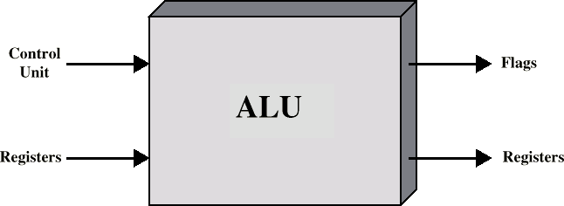
ALU Inputs and Outputs

Slide 5
Operands for arithmetic and logic operations are presented to the ALU in registers, and the results of an operation are stored in registers.
These registers are temporary storage locations within the processor that are connected by signal paths to the ALU.
The ALU may also set flags as the result of an operation.
The flag values are also stored in registers within the processor.
The processor provides signals that control the operation of the ALU and the movement of the data into and out of the ALU.

Slide 6
Addition and Subtraction
Normal binary addition
Monitor sign bit for overflow
Take twos compliment of substahend and add to minuend
— i.e. a - b = a + (-b)
So we only need addition and complement circuits
A | B | Sum
0 | 0 | 0
0 | 1 | 1
1 | 0 | 1
1 | 1 | 0, Carry 1
1 | 1 | 1,Carry 1

Slide 7
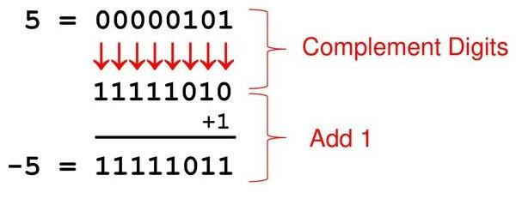
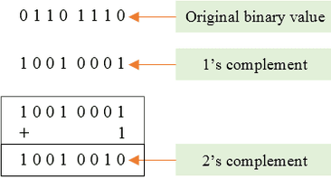
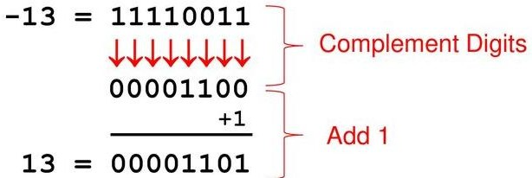
Example of 2’s Compliment

Slide 8
Find 2’s compliment
1000
0100
111001
101010
100000

Slide 9
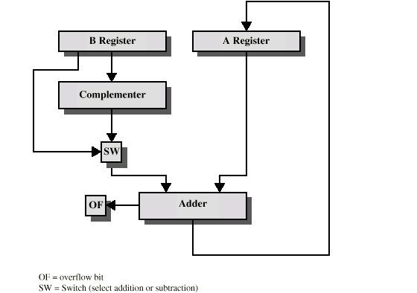
Hardware for Addition and Subtraction

Slide 10
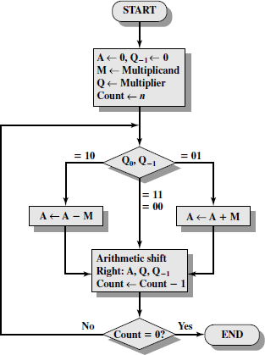
Booth’s Algorithm

Slide 11
Q0 | Q-1 | Result
0 | 0 | Only shift
1 | 1
0 | 1 | A=A + M ,then shift
1 | 0 | A= A – M , then shift
M =7
Q =3
M = 0 1 1 1
Q = 0 0 1 1
- M = 1 0 0 1

Slide 12




Example of Booth’s Algorithm:7(M)*3(Q)
Answer is in A and Q→0001 0101 =21

Slide 13
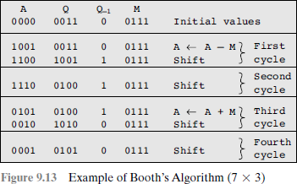

Slide 14
Examples-size of n determines answer
Solve using Booths Algorithm A. M = 5 , Q = 5
B. M = 12, Q = 11
C. M = 9, Q = - 3
D. M = -13 ( 0011 ) , Q = 6
-M=13 (1101)
A. M = -19 , Q = -20

Slide 15
Division
More complex than multiplication
Negative numbers are really bad!
Based on long division

Slide 16
Division of Unsigned Binary Integers
00001101 1011 10010011
Quotient
Dividend
Divisor
1011
001110
1011
Partial Remainders
001111
1011
100
Remainder

Slide 17
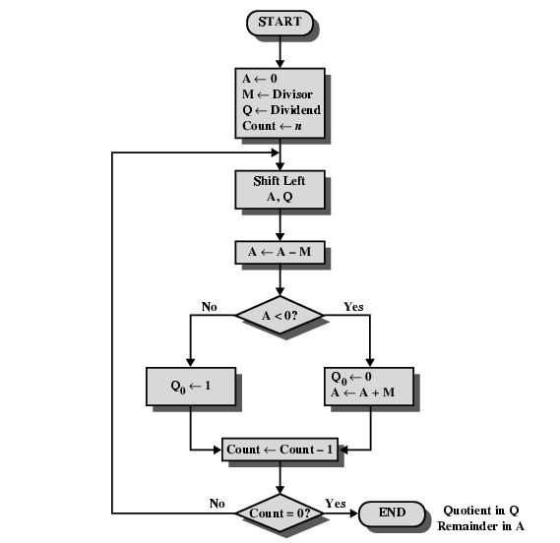
Flowchart for Restoring Division

Slide 18
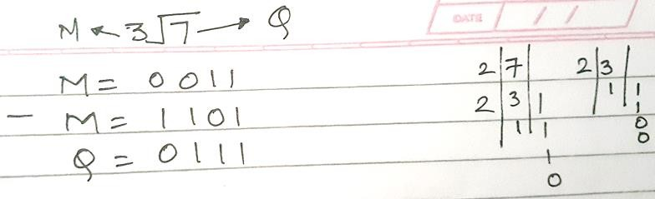
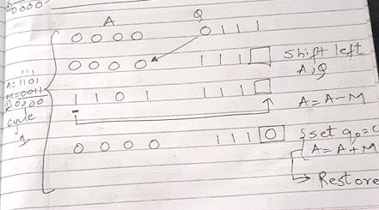

Slide 19
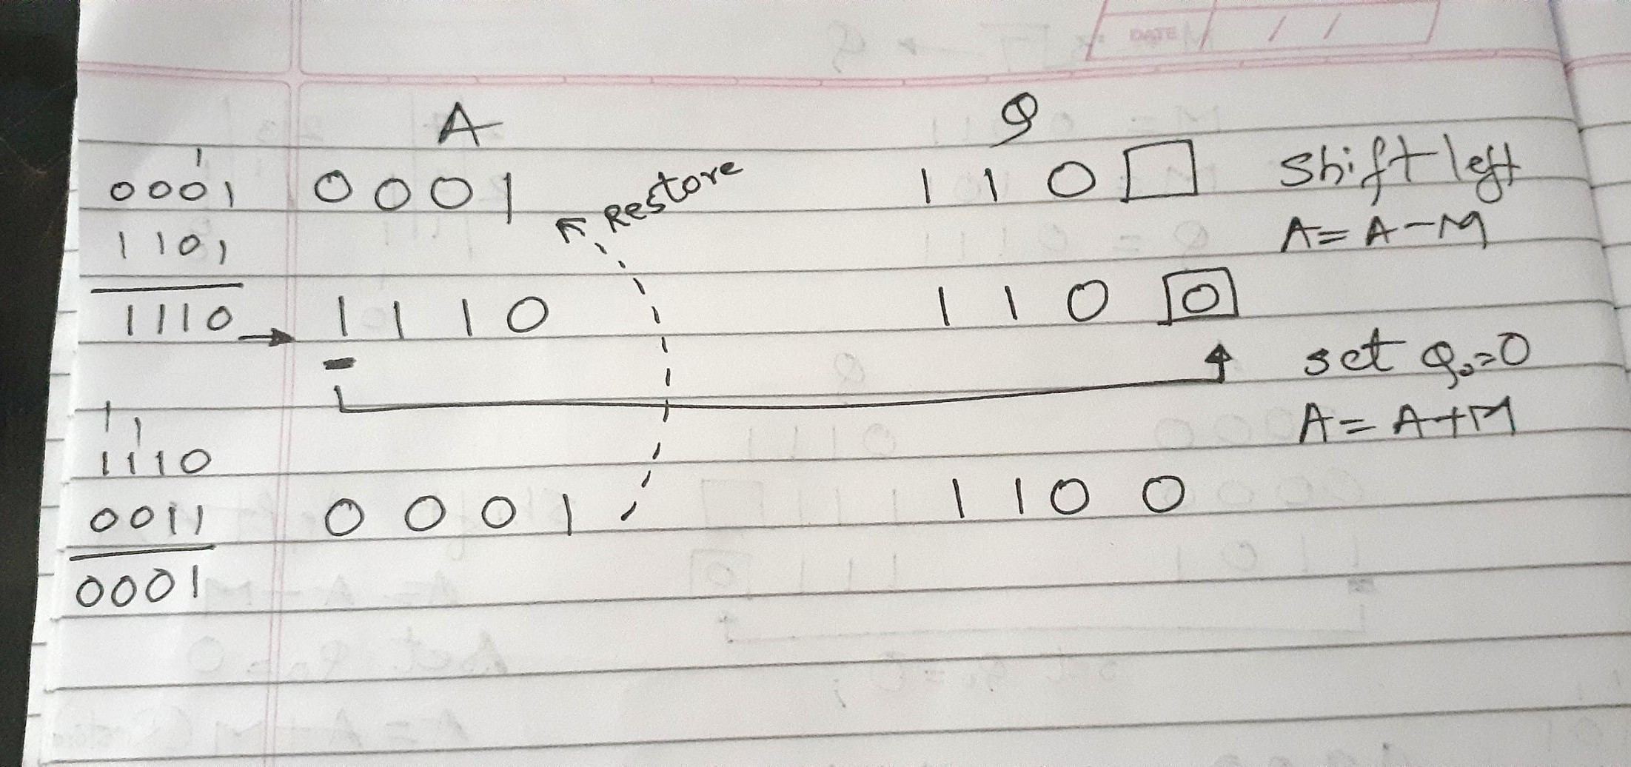

Slide 20
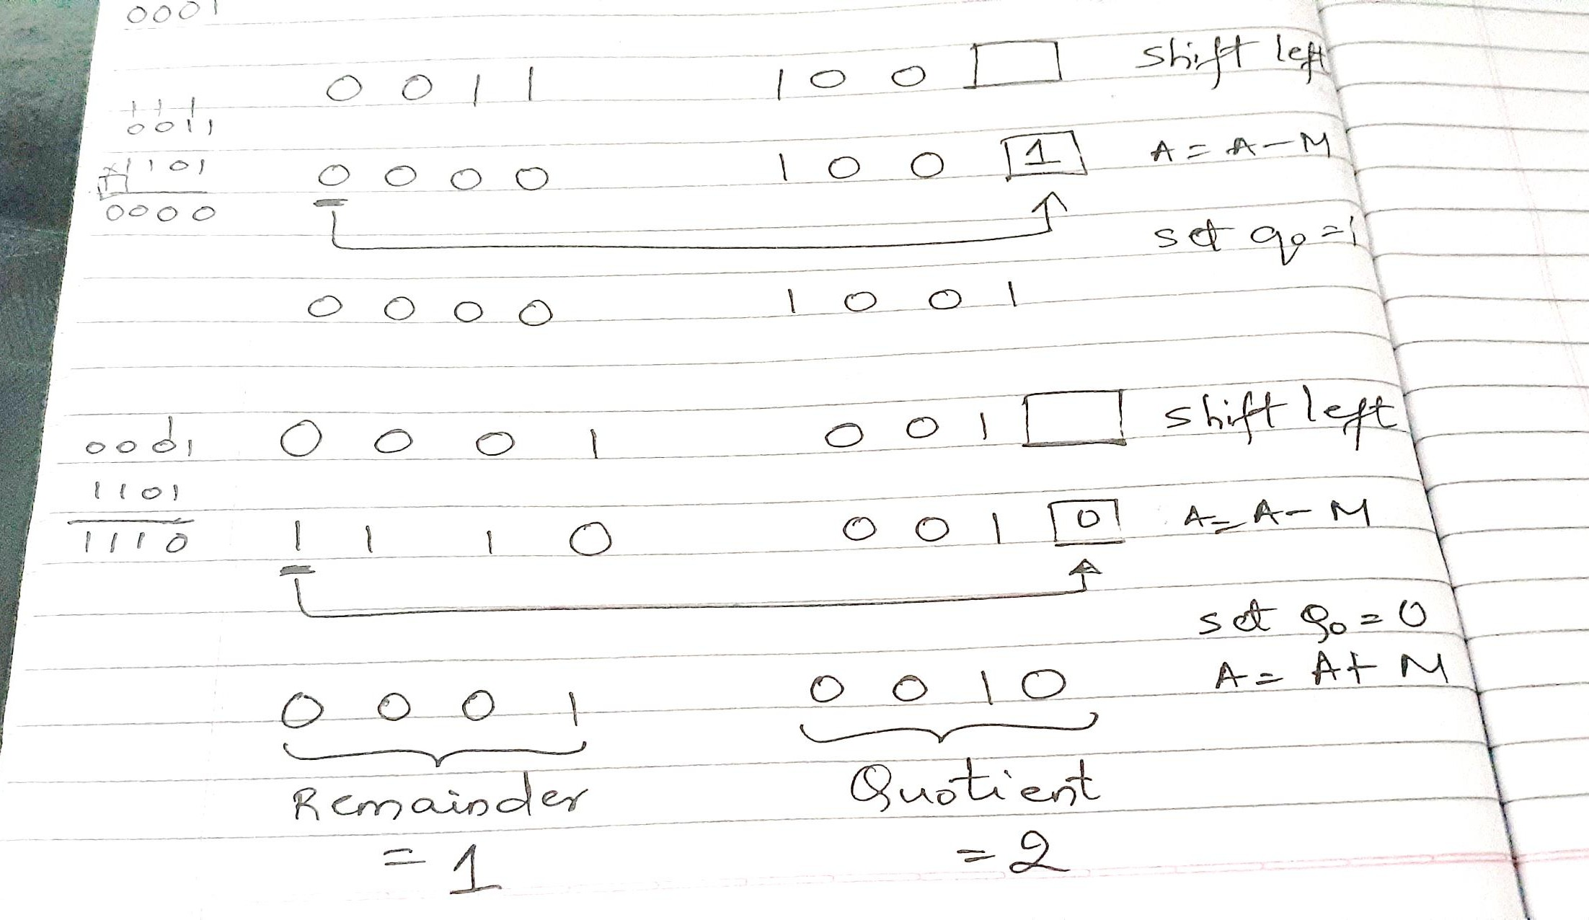

Slide 21
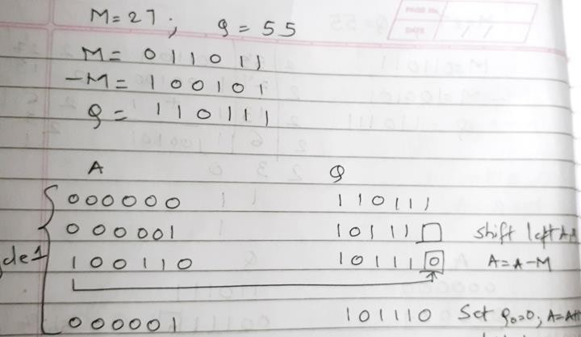

Slide 22
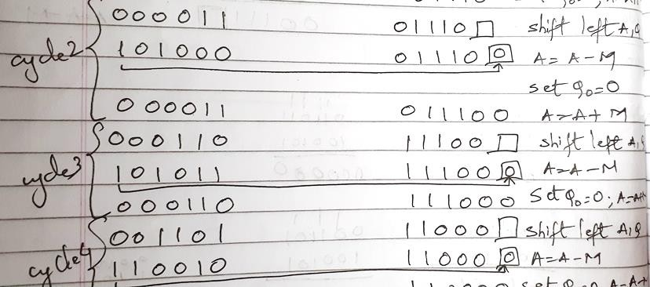

Slide 23
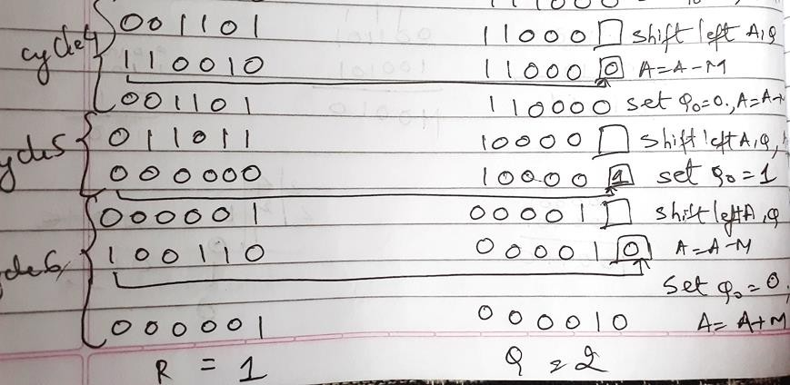

Slide 24
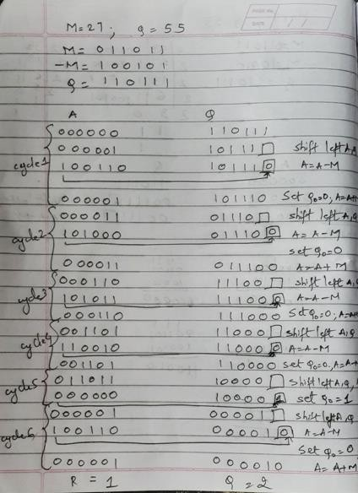

Slide 25
Solve using Restoring Division
A. M = 5 , |  | Q = 5 , A=0000 , Q=0010
B. M = 12, |  | Q = 26, A=00010 , Q= 00010
C. M = 9, |  | Q = 19 , A=00001 , Q =00010
D. M = 32 | , | Q = 59, A=011011, Q=000001
E. M = 17 | , | Q = 42, A=001000 , Q=000010

Slide 26
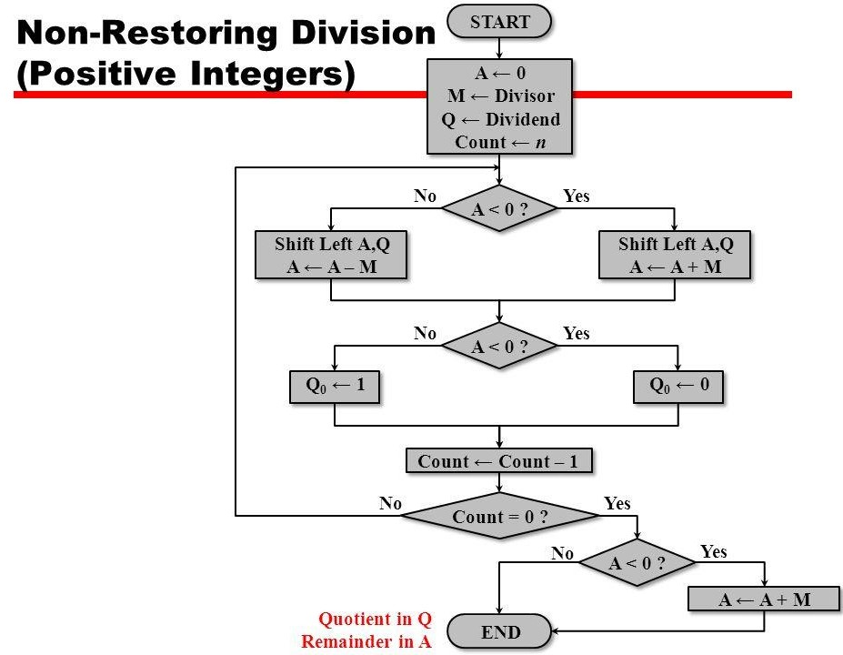

Slide 27
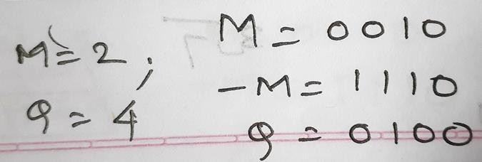
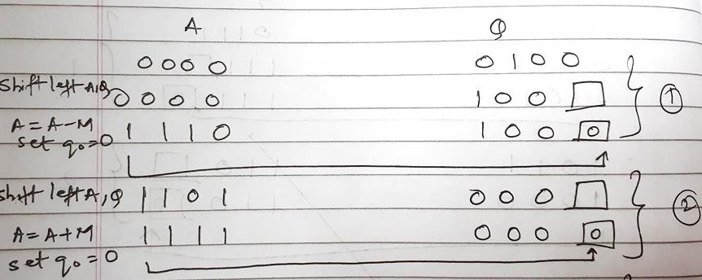

Slide 28
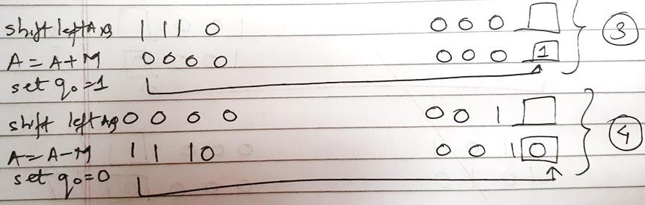
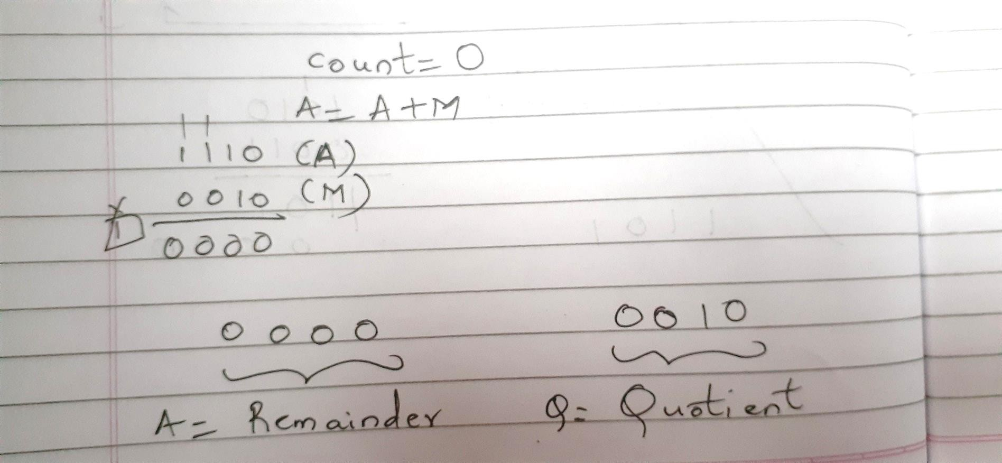

Slide 29
Solve using Non Restoring
A. M = 5 , |  | Q = 5,A=0000,Q=0001.
B. M = 12, |  | Q = 26,A=000010, Q=000010.
C. M = 9, |  | Q = 19,A=00001,Q=00010.
D. M = 32 | , | Q = 59,A=011011,Q=000001.
E. M = 17 | , | Q = 42,A=001000,Q=000010

Slide 30
Booths Recoding / Bit pair recording
STEPS

Slide 31
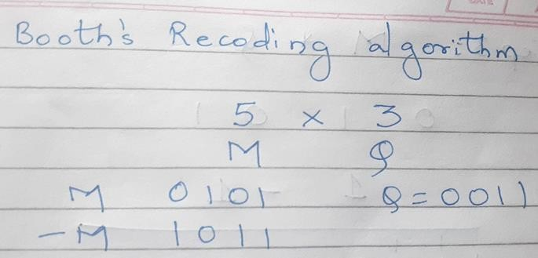

Slide 32
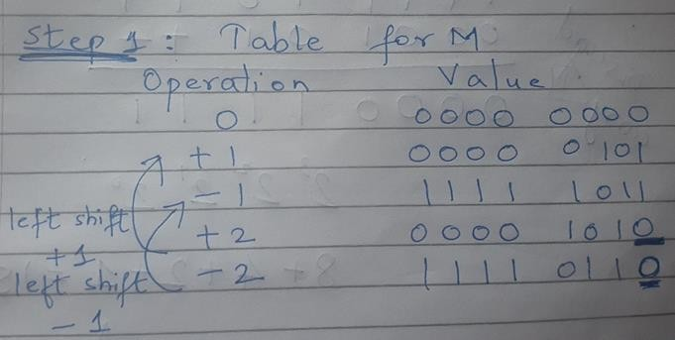

Slide 33
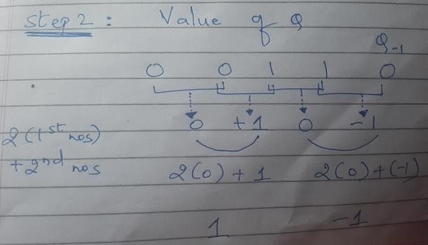

Slide 34
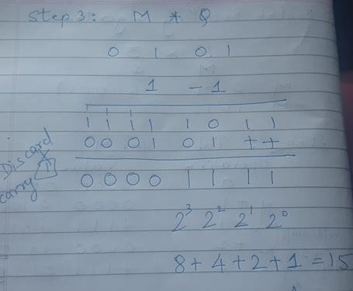

Slide 35
Solve using Booths Recoding
1. M= 5 , Q = 4 (4 bits)= 00010100 (20)
2. M=9 , Q = -6 (5 bits)=11110 01010 (-54)
3. M=15 , Q=-10 (5 bits)=11011 01010(-150)
4. M= -13 ,Q = -20 (6 bits )=000100000100(260)

Slide 36
Sample mix problems-Kindly refrain referring to flowchart.
1. Booth’s Algorithm = 000 100 000 100(260)
A= 110011 (Multiplicand ) B= 101100 (Multiplier)
2. Booth’s Recoding = 0110 1010/11011 01010
M= ( 15 ) Q= ( -10 )
Non Restoring Division
M=11 , Q= 21 , A= 01010 , Q= 00001
Restoring Division
M=14 , Q= 15, A=00001 , Q = 00001

Slide 37
Floating Point
Sign bit | Biased Exponent | Significand or Mantissa
• A floating point number, is a positive or negative whole number with a decimal point. For example, 5.5, 0.25, and -103.342 are all floating point numbers, while 91, and 0 are not
+/- .significand x 2^{exponent}
Misnomer
Point is actually fixed between sign bit and body of mantissa
Exponent indicates place value (point position)

Slide 38
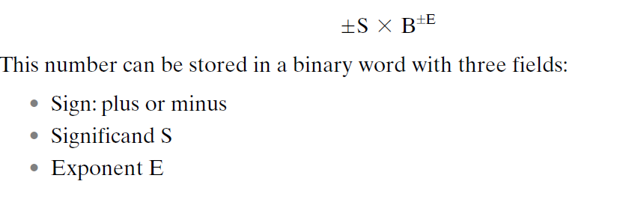

Slide 39
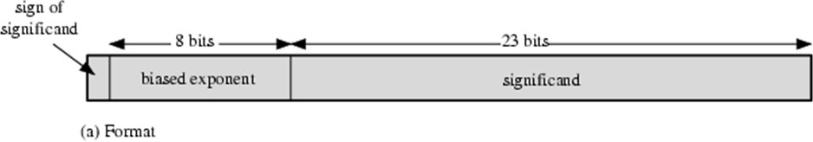
Floating Point Examples
Typical 32-Bit Floating-Point Format
The leftmost bit stores the sign of the number
The exponent value is stored in the next 8 bits.
The representation used is known as a biased representation.
A fixed value, called the bias, is subtracted from the field to get the true exponent value.

Slide 40
Signs for Floating Point
Mantissa is stored in 2s compliment
Exponent is in excess or biased notation
—e.g. Excess (bias) 128 means
—8 bit exponent field
—Pure value range 0-255
—Subtract 128 to get correct value
—Range -128 to +127

Slide 41
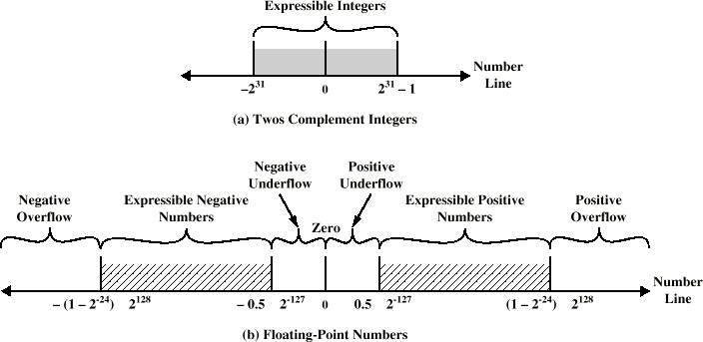
Expressible Numbers

Slide 42
IEEE 754
Standard for floating point storage
developed to facilitate the portability of programs from one processor to another
Defines 32 and 64 bit standards with 8 and 11 bit exponent respectively
the standard defines two extended formats, single and double, whose exact format is implementation dependent.
The extended formats include additional bits in the exponent (extended range) and in the significand (extended precision).
The extended formats are to be used for intermediate calculations.
Extended formats (both mantissa and exponent) for intermediate results

Slide 43
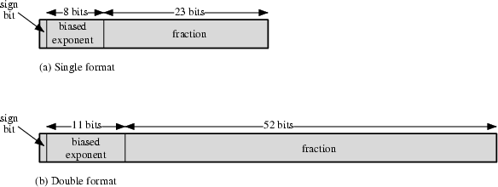
IEEE 754 Formats
(1.N)2^{E-127}
32 BIT
64 BIT
_{(1.N)2}E-1023

Slide 44
Steps
1. Convert Decimal to Binary
2. Normalization
— Rewriting Step 1 into (1.N) form
— Ex: 1 1 1 . 0 1 1 = 1 . 1 1 0 1 1 X 2 ²
Exponent
— Ex: 0 . 0 0 0 1 0 = 0 0 0 0 1 . 0 X 2 -⁴
3.Biasing
— Applying Single Precision (E – 1 2 7) & Double Precision ( E – 1 0 2 3 ) on exponent from Step 2
4. Representation in Single (32 bit )and Double Precision (64 bit ) Format

Slide 45
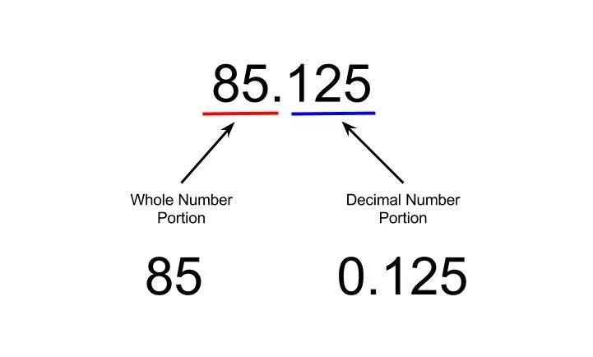
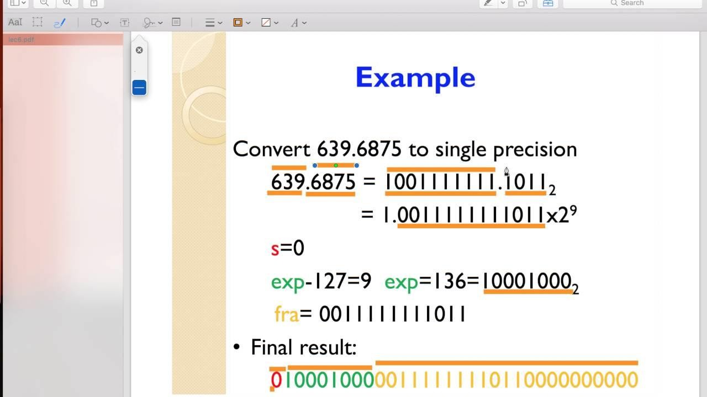

Slide 46
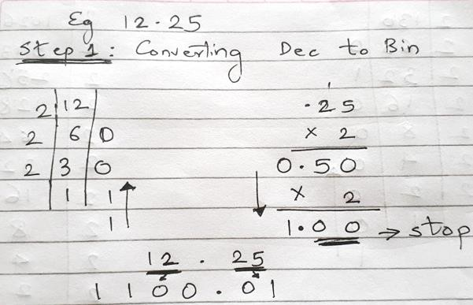
Solved Example

Slide 47
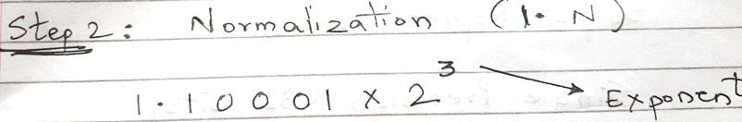
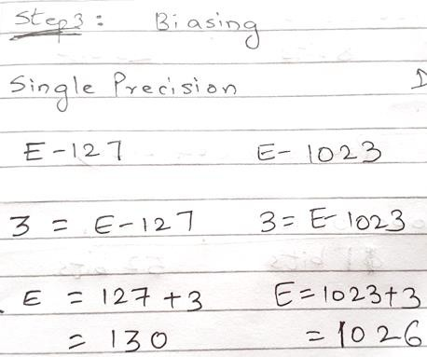


Slide 48
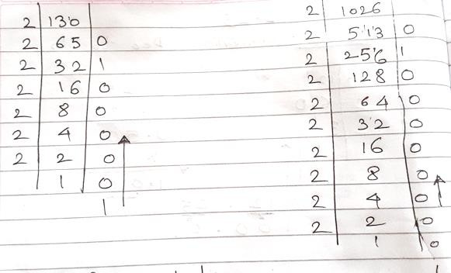

Slide 49
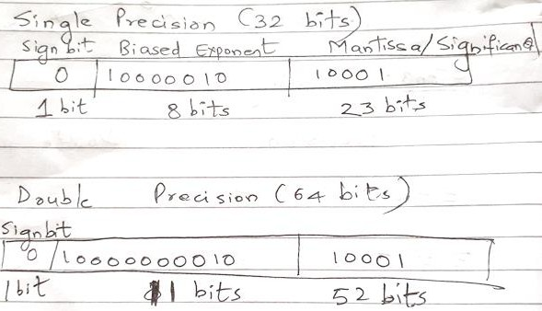

Slide 50
Solve
25.44
SP- 0|100000|1001 0111 0000 1010 0011 110
DP- 0|10000000011|1001 0111 0000 1010 0011 110
0.00635
SP- 0|1110111|00000001101000…
DP- 0|1111110111|00000001101000… SP- 1 | 10000101| 1111 010001
DP- 1 | 10000000101| 1111 010001
-125.10
-13.54
SP- 1|10000010|10110001010
DP- 1|10000000010|10110001010

Slide 51
Sample Problems to Solve
1) 178.1875
SP 0|10000110|01100100011 DP 0|10000000110|
1) 309.175
SP 0|10000111|01011101001011 DP 0|10000000111|
1) 1259.125
SP 0|10001001|0011101011001000…(9 zeroes) DP 0|10000001001|010100111100
1) 0.0625
SP 0|01111011|0000000…. DP 0|01111111|00000…..

Slide 52
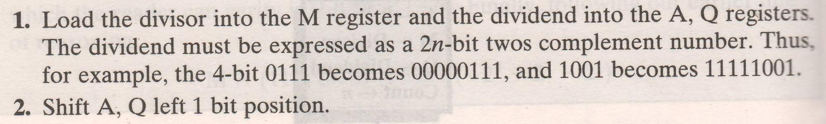
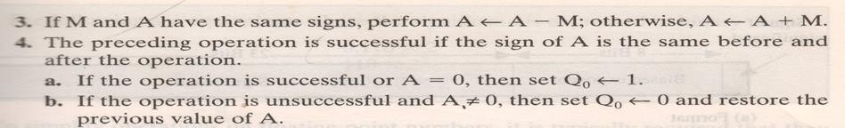

Division of signed numbers

Slide 53
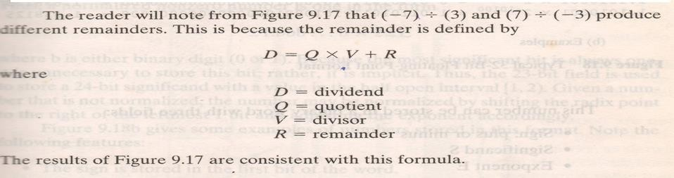

Slide 54
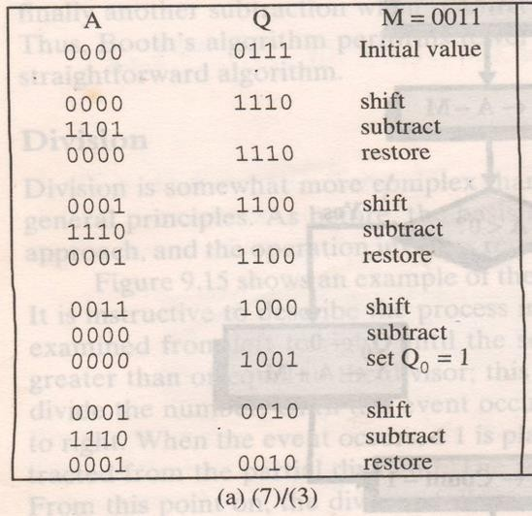

Slide 55
Solve
a) 7 / -3
b) -7 (Q) / 3 (M)
c) -7 (Q) / -3 (M)

Slide 56
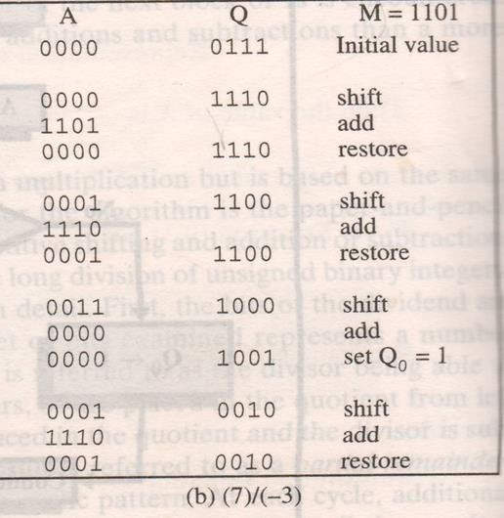

Slide 57
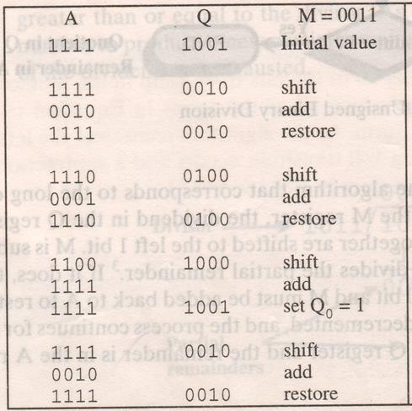


Slide 58
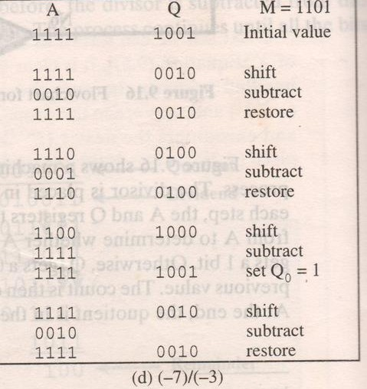

Slide 59
Dividend negative → Remainder –ve

Slide 60
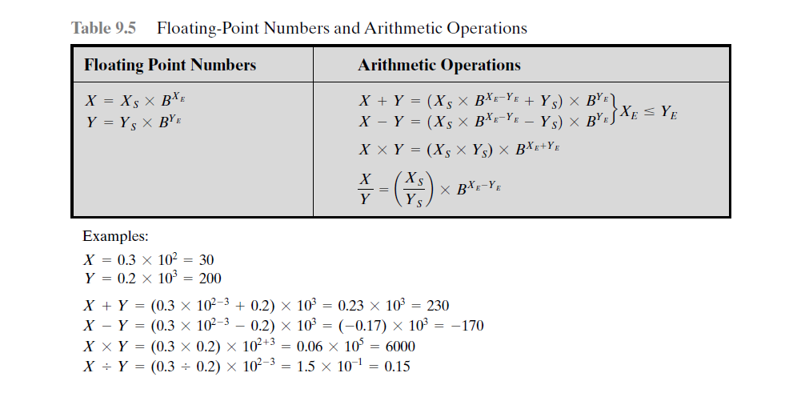

Slide 61
4 phases of FP Arithmetic +/-
Check for zeros
Align significands (adjusting exponents)
Add or subtract significands
Normalize result

Slide 62
Floating Point Addition
Add the following two decimal numbers in scientific notation:
8.70 × 10⁻¹ with 9.95 × 10¹
Rewrite the smaller number such that its exponent matches with the exponent of the larger number.
8.70 × 10⁻¹ = 0.087 (Note ! ) × 10¹

Slide 63
Add the mantissas
9.95 + 0.087 = 10.037 and
write the sum 10.037 × 10¹
Put the result in Normalised Form 10.037 × 10¹ = 1.0037 × 10²
(shift mantissa, adjust exponent)

Slide 64
Check for overflow/underflow of the exponent after normalisation
Overflow
The exponent is too large to be represented in the Exponent field
Underflow
The number is too small to be represented in the Exponent field

Slide 65
Round the result
If the mantissa does not fit in the space reserved for it, it has to be rounded off.
For Example: If only 4 digits are allowed for
mantissa
1.0037 × 10² ===> 1.004 × 10²

Slide 66
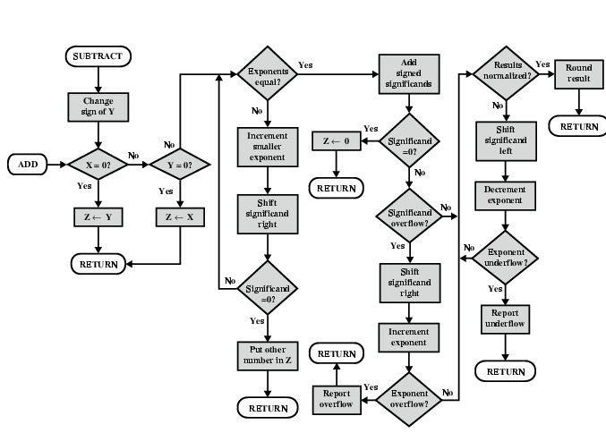
FP Addition & Subtraction Flowchart

Slide 67
FP Arithmetic x/÷
Check for zero
Add/subtract exponents
Multiply/divide significands (watch sign)
Normalize
Round
All intermediate results should be in double length storage

Slide 68
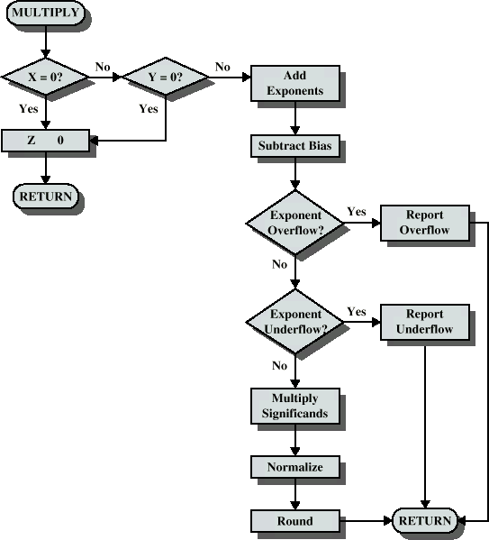
Floating Point Multiplication

Slide 69
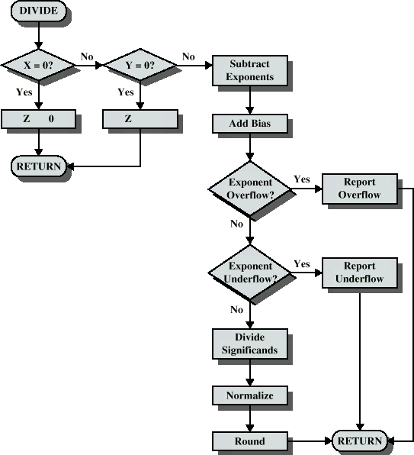
Floating Point Division

